Slide 1
EMSE 2801, 4190 & 6801 AI Use Policy
8/9/2025
Prof. Eric Dano
Email: ericdano@gwu.edu

Slide 2
Overview and AI Use Example

Slide 3
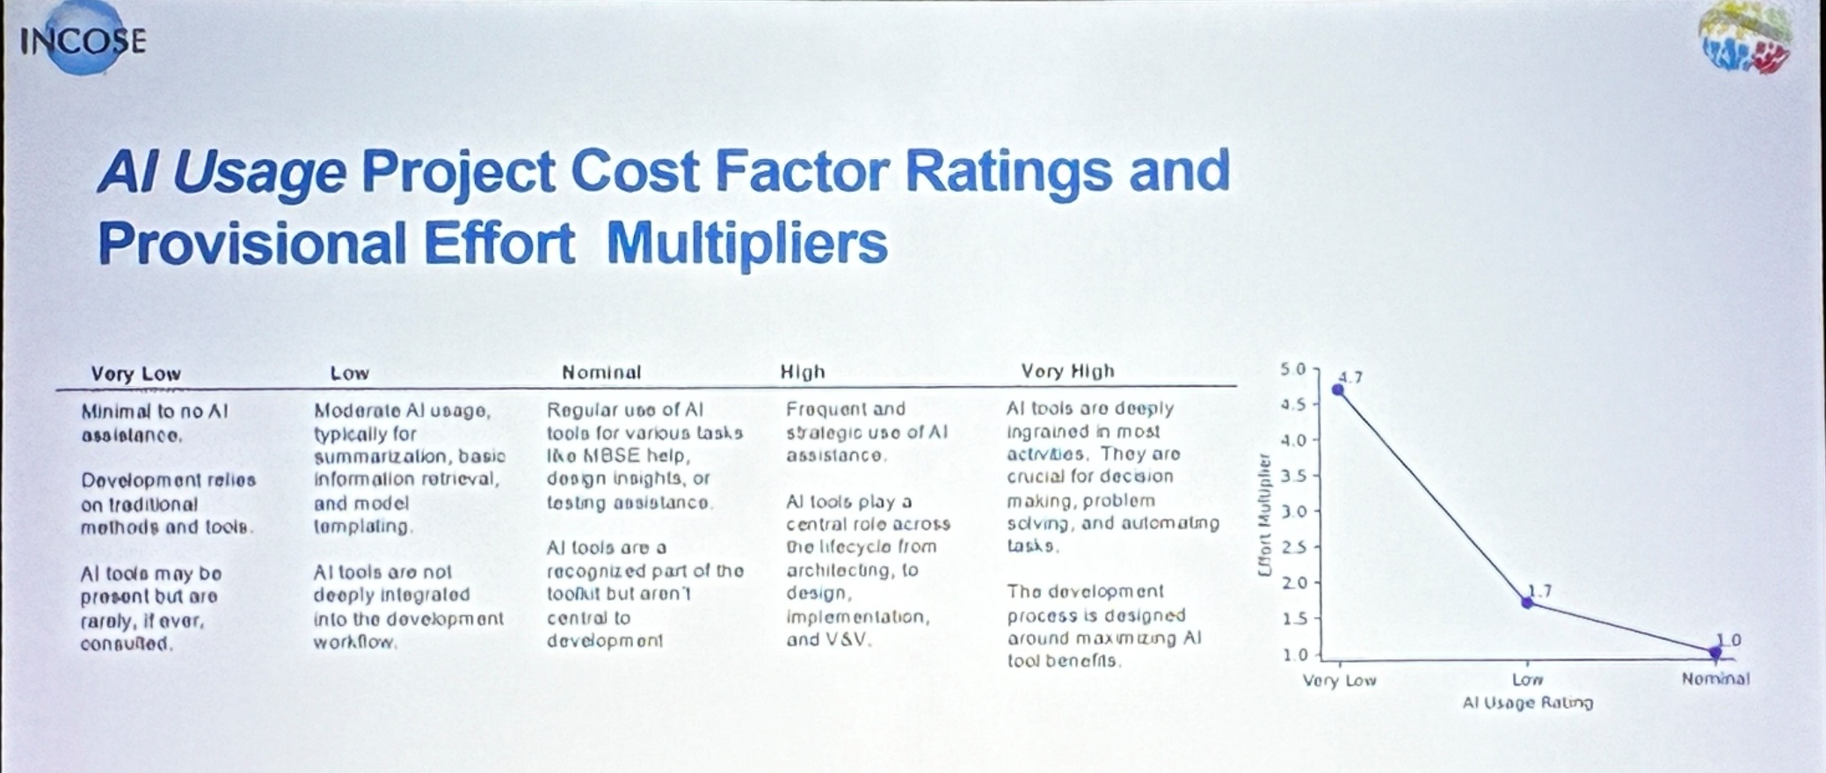
Why an AI Policy?
Graduating engineers will be expected to be able to use AI as a “co-pilot” to assist and improve their SE artifacts . . .
. . . but, AI does not replace detailed literature reviews, finding/reading multiple sources and information validation!

Slide 4
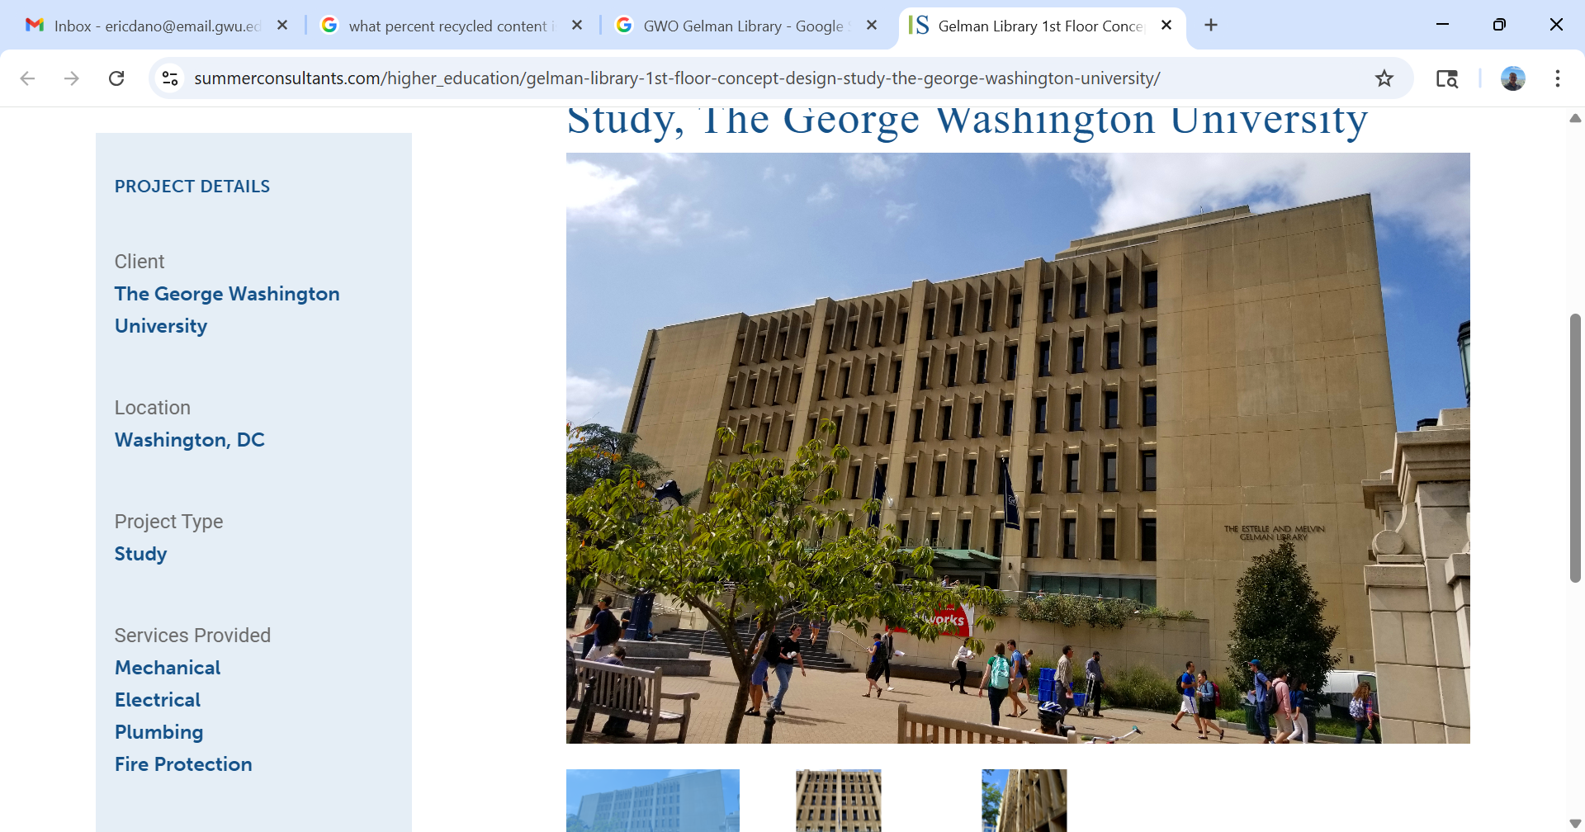

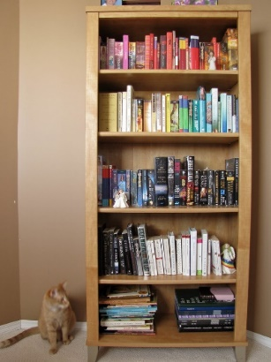
AI expands access to millions of sources
Image source: https://content.expert.ai/blog/enterprise-llms-of-the-future-bigger-is-not-better/
10s of sources
1,000s of sources
1,000,000s of sources
Coverage/
Speed
Prompts
Trust
Low/Slow
Medium/Slow
High/ Fast
None
Directed Searches
Prompts
High
High
Low/mid

Slide 5
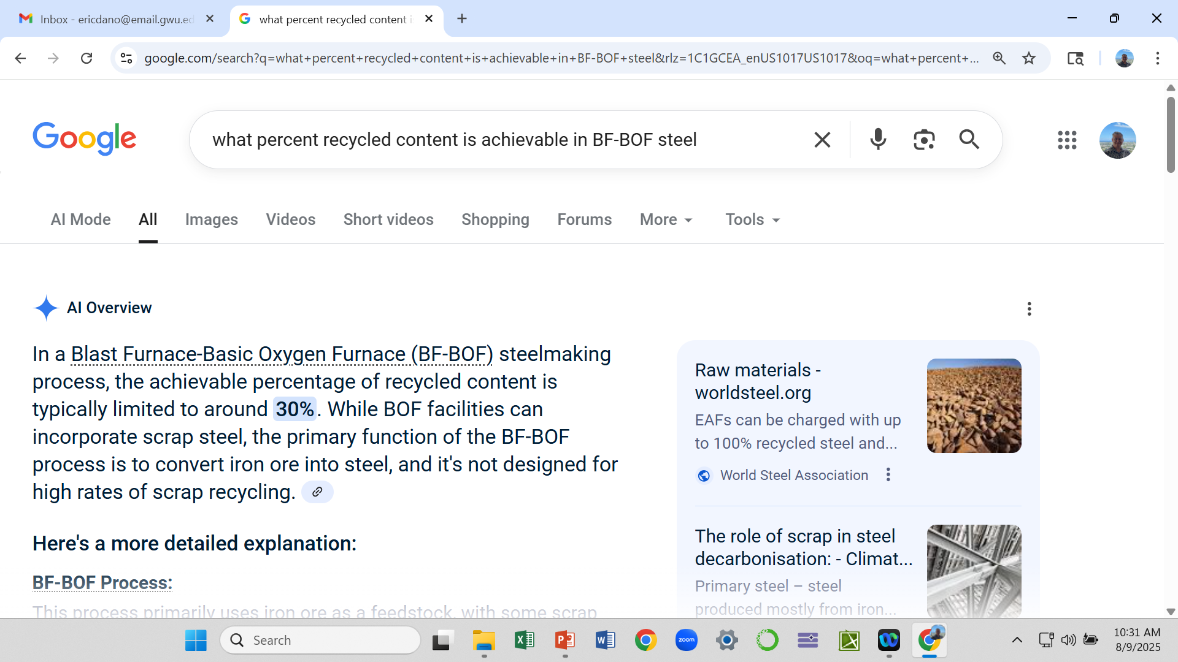
Example: % Recycle content in Steel
Prompt
Source
Based on this, the student wrote that %RC Steel > 30% was physically impossible, yet the customer told us that they already used some 50%RC steel !!??

Slide 6
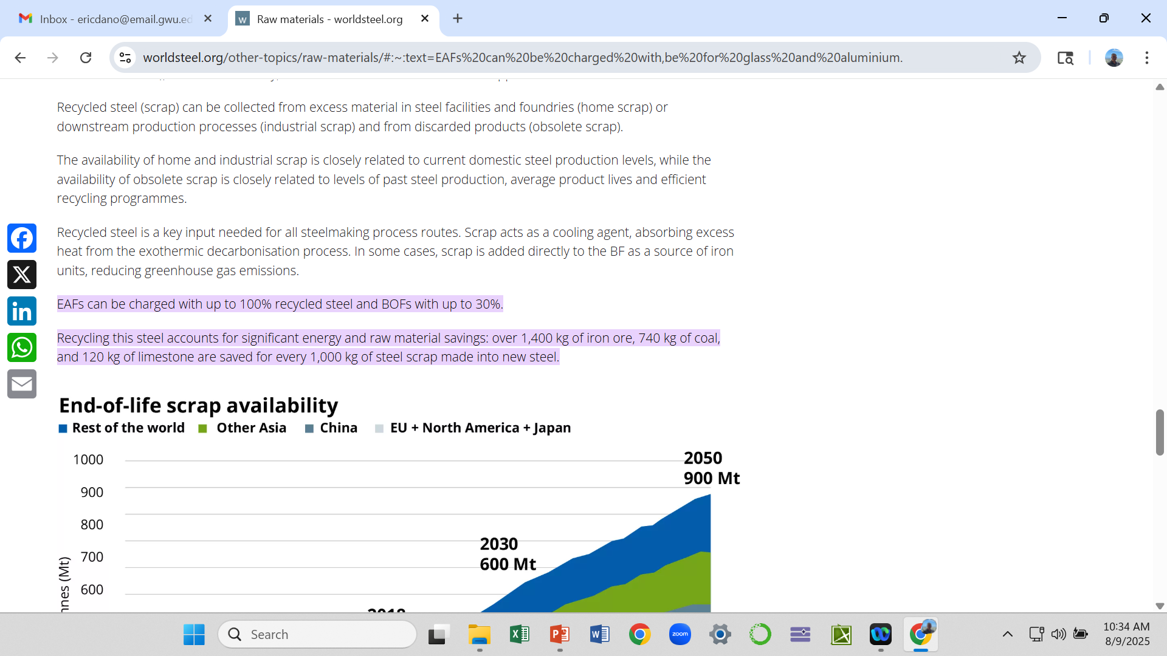
The source of the information was provided by AI, but was never examined
Source
Do not use insufficient or unvalidated data !!!

Slide 7
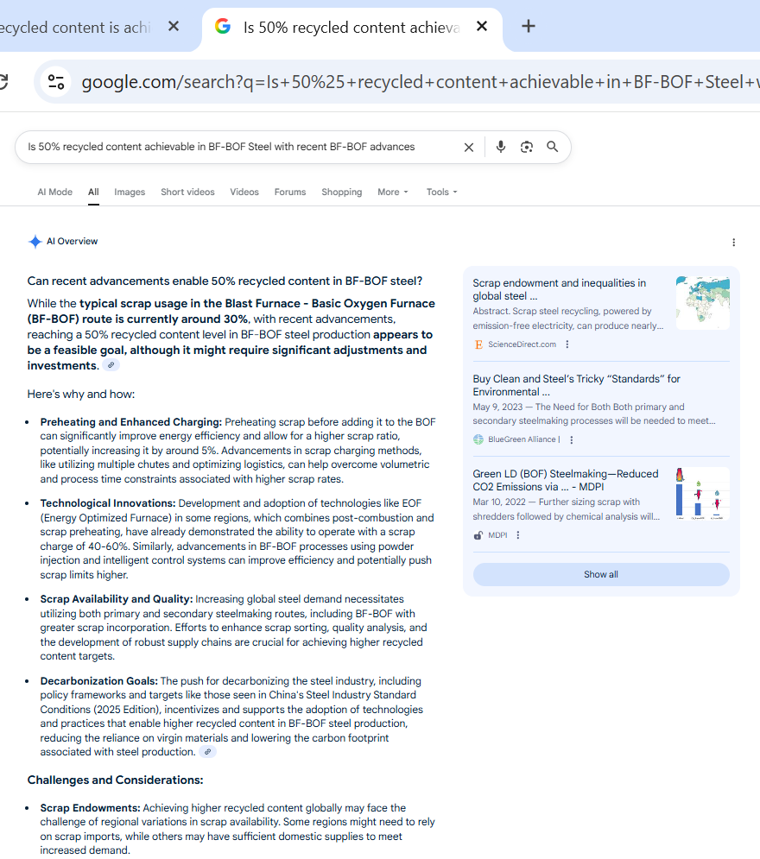
Digging Further with Prompt #1
Is 50% recycled content achievable in BF-BOF Steel
Can Recent Advancements enable 50% recycled content in BF-BOF Steel
Juried scientific paper
It is feasible
and
Here is how it is feasible
The improvements can then be further researched as part of the lit review (see how supply chain is a factor)

Slide 8
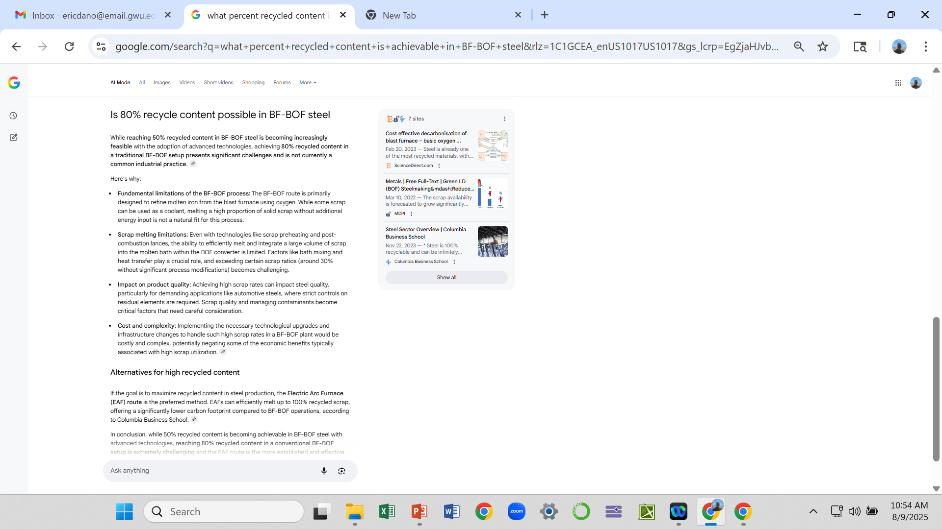
Digging further with Prompt #2
Significant limitations will prevent going from 50%RC to 80%RC BF-BOF steel are listed

Slide 9
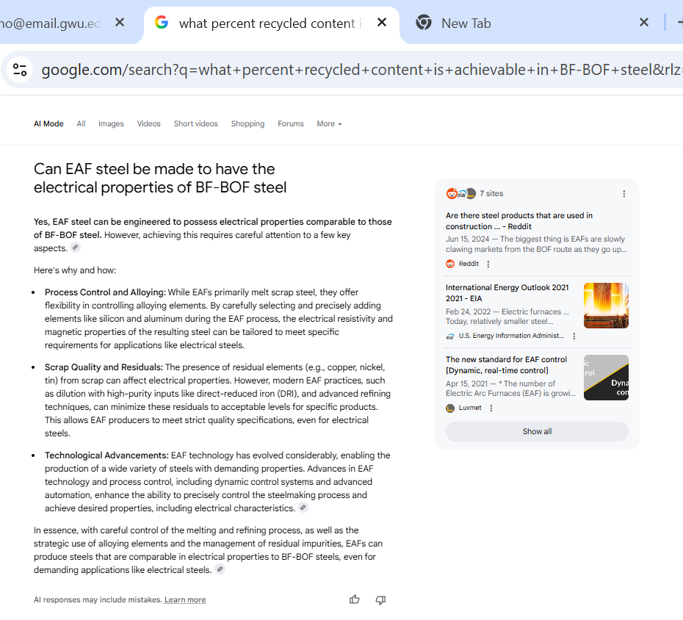
Digging even further with Prompt #3
EAF steel may be required to meet 80%RC Steel content and still maintaining desired electrical properties

Slide 10
Which story do you want to tell your customer, who is already using 50%RC Steel in some products and needs 80%RC Steel?
A: %RC BF-BOF Steel > 30% is impossible and the customer must be lying to us about using 50%RC Steel
Horrible use of AI w/ No Literature review or Validation
B: 50%RC BF-BOF Steel is possible based on current technology improvements to the BF-BOF process (provide list of improvements). Getting 80% BF-BOF Steel will be difficult due to the fundamental BF-BOF process limitations (list limitations). However, there are currently technology improvements being made to the EAF steel process to allow JIS G3302 compliant steel to be made at high %RC levels (list EAF improvements). The customer should closely follow the roadmaps for BF-BOF and EAF steel to determine which technology is the most appropriate for a desired %RC content.
Great use of AI to dig down and find the desired information AND sources to pull for the Lit Review so that the findings can be Validated

Slide 11
Example Take-Aways
Do . . .
Let AI help find sources of information
Use AI to find information unobtainable form legacy means (library, internet)
Do use AI as a co-pilot to assist you (find sources, assess your submittals, Create figures, etc.)
Don’t . . .
Trust AI without verification
Use AI text as your text. Learn from the AI responses and then write your unique version in the text
Use AI results without reading the sources and ensuring the source is sufficient and validated by other sources

Slide 12
Documenting AI Use Example

Slide 13
All AI Use must be documented (ex Prompt #1)
In text, AI references will be called out in circular brackets and expanded upon in the AI Appendix in written reports:
Pushing Percent recycled content in BF-BOF Steel to 50% recycled content will require the following technology and supply chain improvements [1],[2],(1):
Preheating Scrap Steel for BF-BOF
Enhanced charging (i.e. feeding) of steel into the BOF
Enhance control systems
Using accelerants in the BF-BOF process
Use of Energy Optimized Furnaces
Using cleaner scrap (i.e. supply chain of high quality steel scrap)

Slide 14
All AI Use must be documented (cont.)
References from the AI search must be listed. In this example, Ref [1] and [2] were found from AI Search (1)
Pushing Percent recycled content in BF-BOF Steel to 50% recycled content will require the following technology and supply chain improvements [1],[2],(1):
Preheating Scrap Steel for BF-BOF
Enhanced charging (i.e. feeding) of steel into the BOF
Enhance control systems
Using accelerants in the BF-BOF process
Use of Energy Optimized Furnaces
Using cleaner scrap (i.e. supply chain of high quality steel scrap)
Bibliography
[1] M. Rumsa, M. John, W. Biswas, “Global steel decarbonization roadmaps: Near-zero by 2050,” Elsevier, Environmental Impact Assessment Review, vol. 112, 107807, 2025.
[2] B. Voraberger, et. al., “Green LD (BOF) Steelmaking—Reduced CO2 Emissions via Increased Scrap Rate,” Metals, 12(3), 466, March 2022.

Slide 15
All AI Use must be documented (cont.)
Appendix # - AI Interactions
Search Title:
50% recycled content Steel
Prompt(s) or customizations used:
Can Recent Advancements enable 50% recycled content in BF-BOF Steel?
Files entered:
None
References found and used: [1], [2]
Summary Findings:
50%RC BF-BOF Steel is possible based on current technology improvements to the BF-BOF process (provide list of improvements)
References supporting data Validation:
[1] and [2] were validated with EMSE ME materials SME, I. M. SME, Ph.D. and also align with other steel industry information on BF-BOF tech insertion e.g.:
https://www.aist.org/AIST/aist/AIST/Conferences_Exhibitions/AISTech/Transactions/10715-398.pdf

Slide 16
Not AI, But . . . . . . . . This will really help you!!

Slide 17
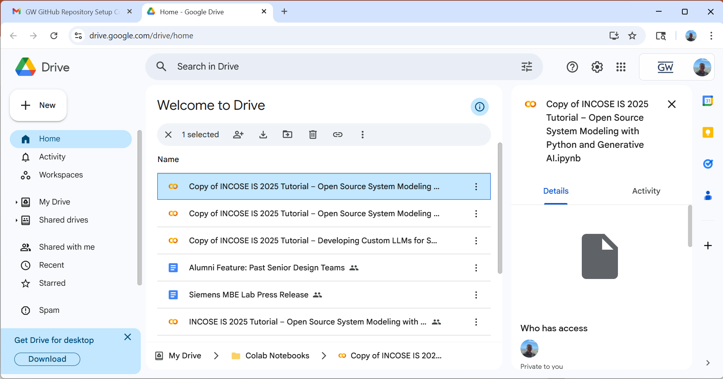
Python SE_Lib provides powerful tools to assist capstones
Install library using: pip install -q se-lib
Include library using: import selib as se
Create from text:
Sequence diagram
Use Case diagram
Activity diagram
Stock & Flows
Causal Loop
Fault Tree
Critical Path analysis
Google Colab can be used like Jupyter Notebooks to develop Python code and use the selib libraries to create SE artifacts

Slide 18
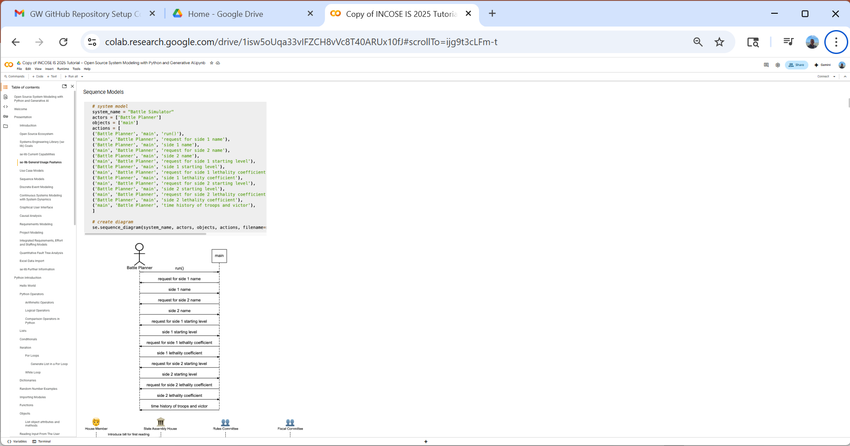
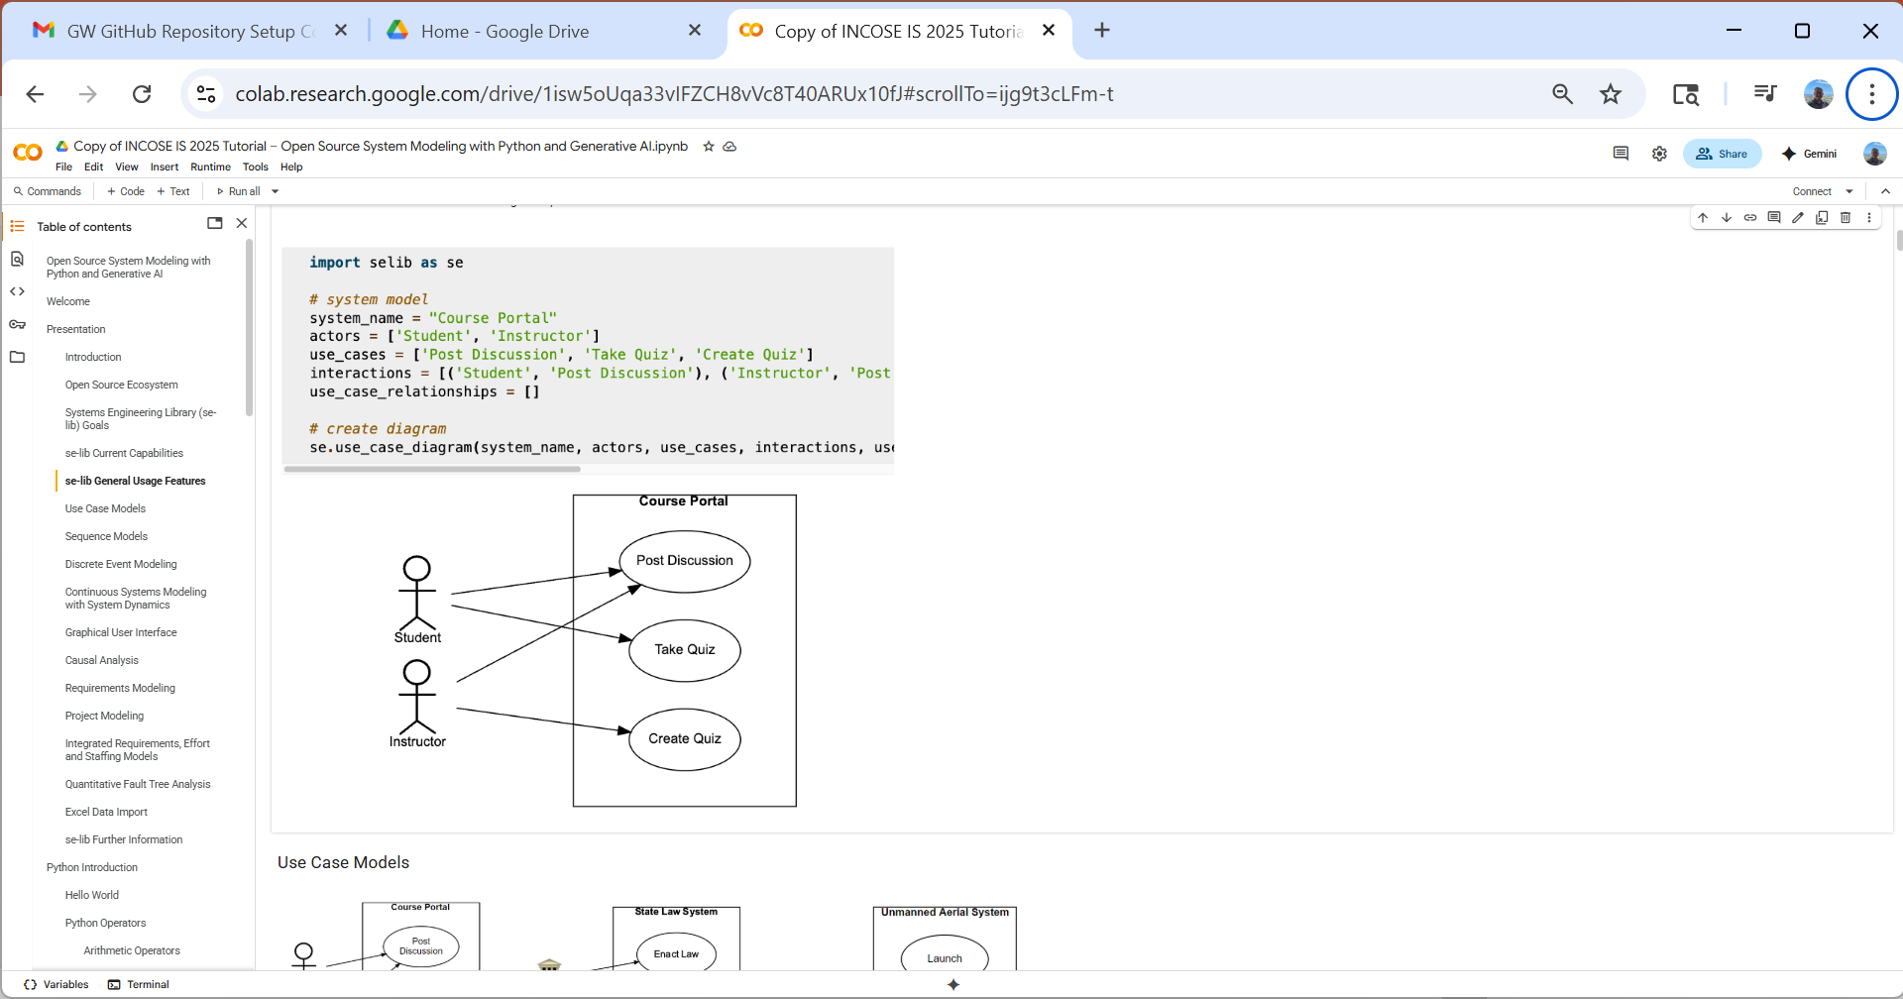

Slide 19
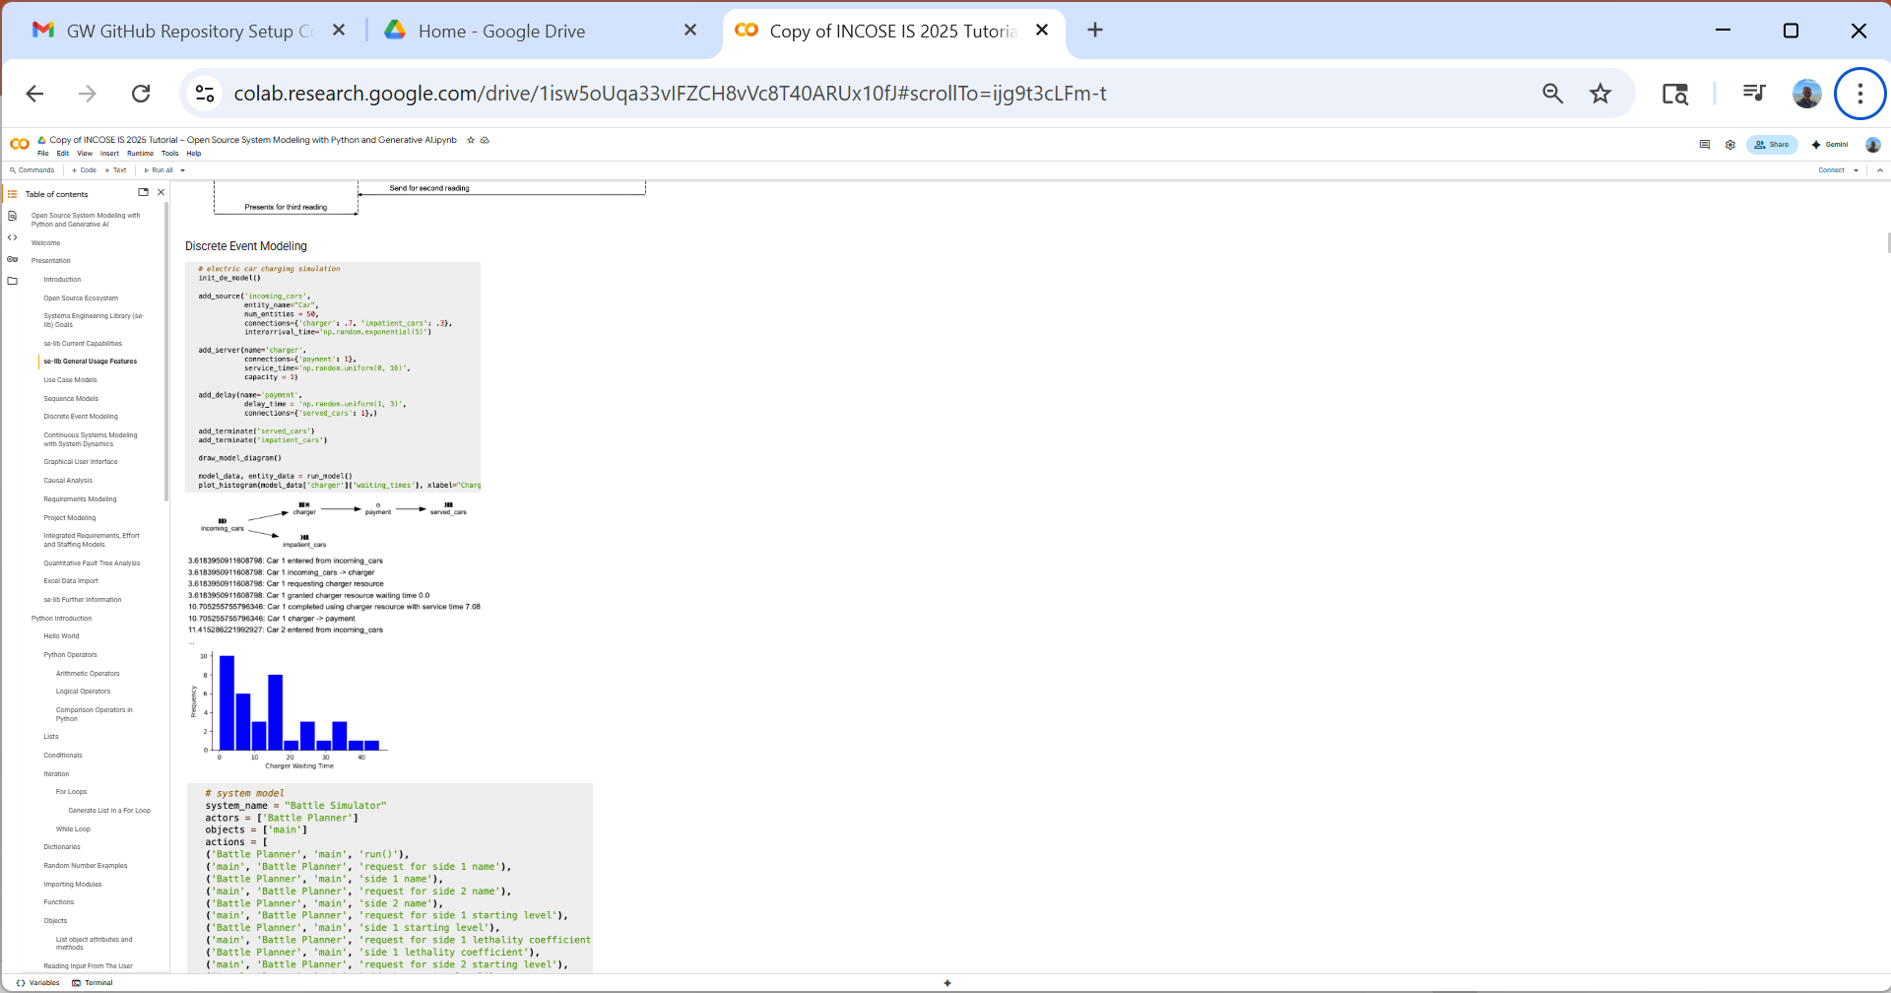
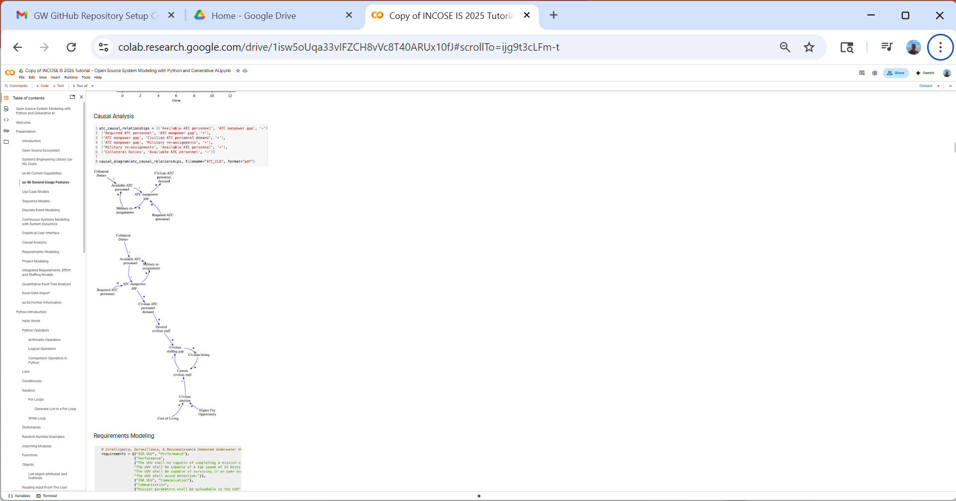

Slide 20
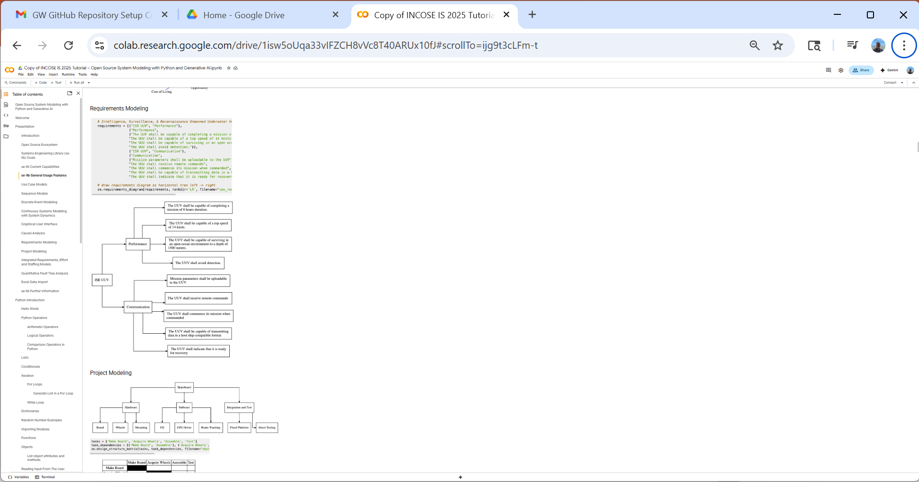
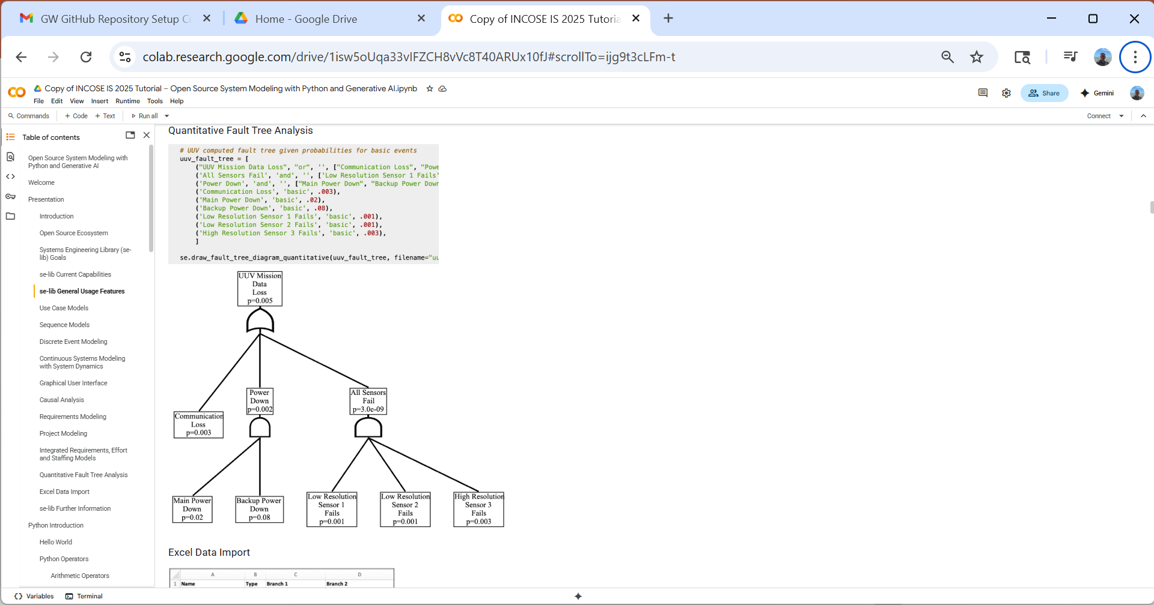

Slide 21
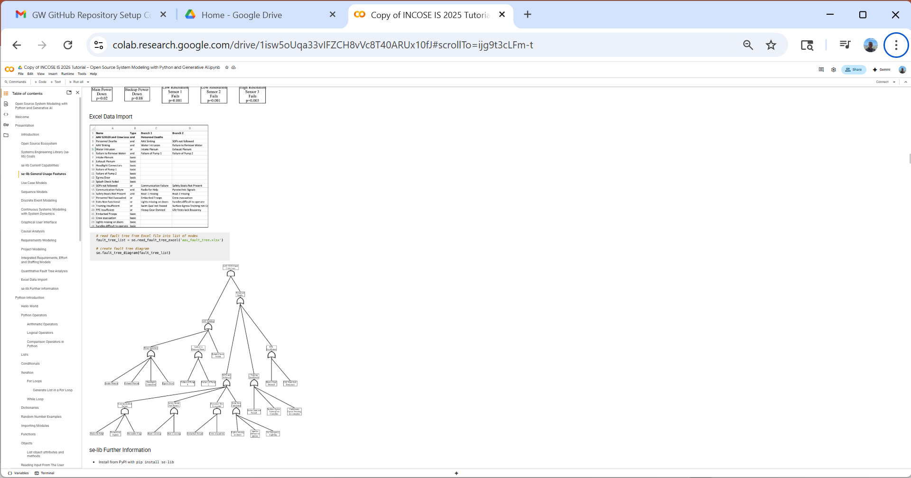
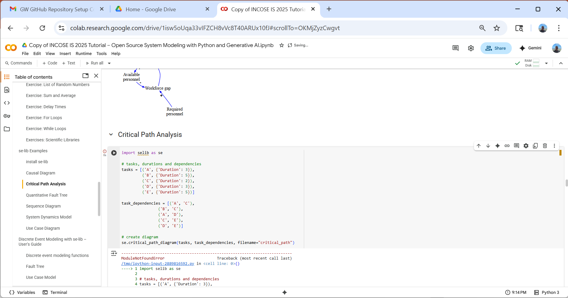

Slide 22
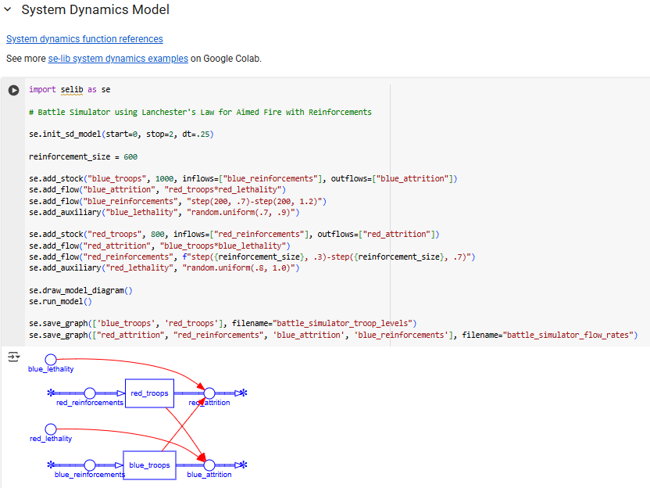
AI can be used through Python interfaces to check and make recommendations on artifacts

Slide 23


